Slide 1

SPARSE PRINCIPAL COMPONENT ANALYSIS
Hui Zou, Trevor Hastie & Robert Tibshirani
STA315 - Advanced Statistical Learning
Presented by Mohammed Yusuf Shaikh

Slide 2
PRINCIPAL COMPONENT ANALYSIS
Data Processing & Dimension Reduction
Goal: Finding Orthogonal variables (Principal Component) that captures maximum variance
Compressing data while retaining important information
IMAGE RECOGINTION
GENE EXPRESSION ANALYSIS

Slide 3


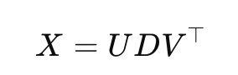
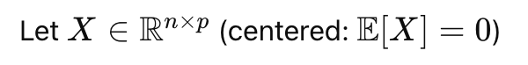

How to compute PCA?
Singular Value Decomposition (SVD)
Z = UD is the matrix of principal component scores. The data points in the reduced-dimensional space.
U contain eigenvectors (directions)
D contains eigenvalues (amount of variance captured by PC)
Columns of V are the loadings how much each original variable contributes to each principal component.

Slide 4



Limitations of PCA
Lack of Sparsity - doesn’t do variable selection
The loadings are usually nonzero, making it hard to interpret which variables that are truly important.
Does not capture non-linear relationship
Outliers can affect direction of principal components

Slide 5



Overcoming PCA Limitation
Rotation Techniques
Vines Method
Makes it easier to interpret each PC as being associated with a smaller subset of variables
Restricting loadings to a small set of values like 0, 1, and −1 to simplify interpretation.
Thresholding Approach
Set the loadings with absolute values smaller than a threshold to zero
Can be potentially misleading in various respects

Slide 6

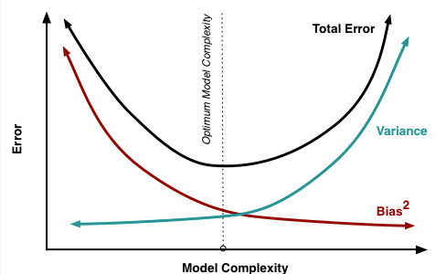


Lasso Regression: Shrinking Towards Sparsity
Pros
Selects the most important variables
Sets less relevant coefficients to exactly zero, when λ is large
Helps in model interpretability through the bias-variance trade-off
Works well when n > p
Cons
When p > n, lasso can select at most n variables.

Slide 7
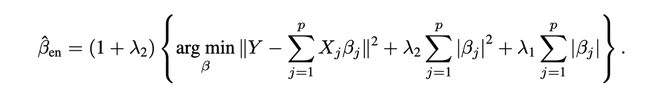


Elastic Net Regression
Elastic Net extends lasso to overcome its LASSO drawbacks while preserving all properties
Is a combination of the ridge (L2​) and lasso (L1​) penalties.
When λ₂ = 0 → Elastic Net = Lasso
When p > n, using λ₂ > 0 allows more than n variables to be selected

Slide 8
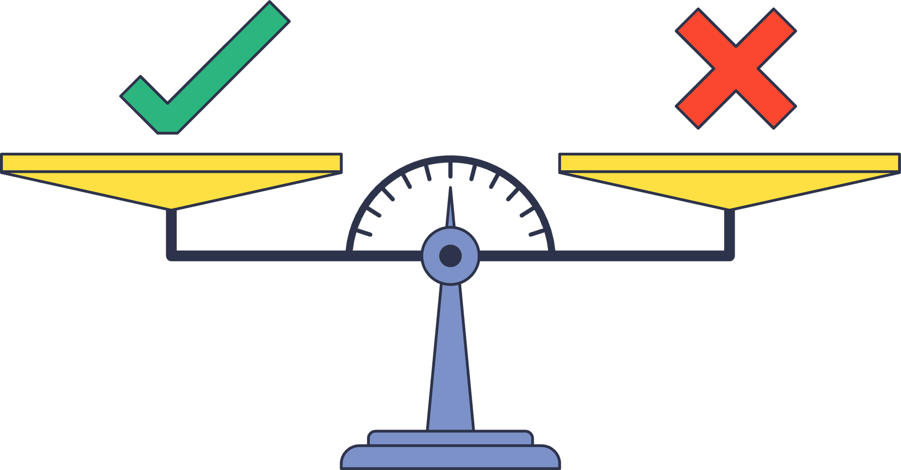

Sparse Component Technique using LASSO
Pros
An early attempt to introduce sparsity in PCA by imposing L1 constraint
Tuning parameter t, sufficiently small t forces some loading to be exactly 0
Cons
There is no clear method to determine an optimal t, requiring multiple trial values.
High computational cost
Fails to produce sufficiently sparse loadings while maintaining a high percentage of explained variance.

Slide 9
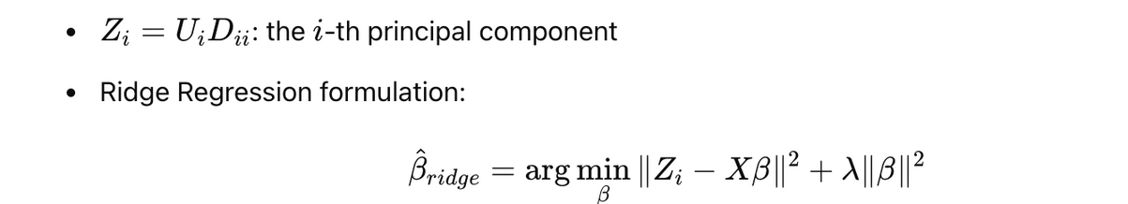
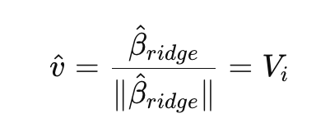
From PCA to Sparse PCA via Regression
Theorem 1: PCA as Ridge Regression
Where,
Why Ridge is Needed?
If p > n, OLS has no unique solution
PCA is always have unique solution while utilizing SVD
Ridge penalty removes indeterminacy and ensures stability
After normalization, the result is independent of λ

Slide 10

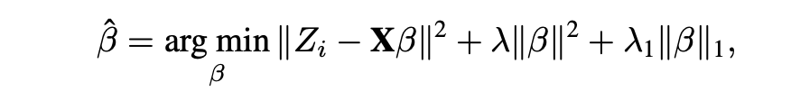
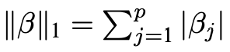
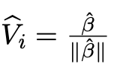
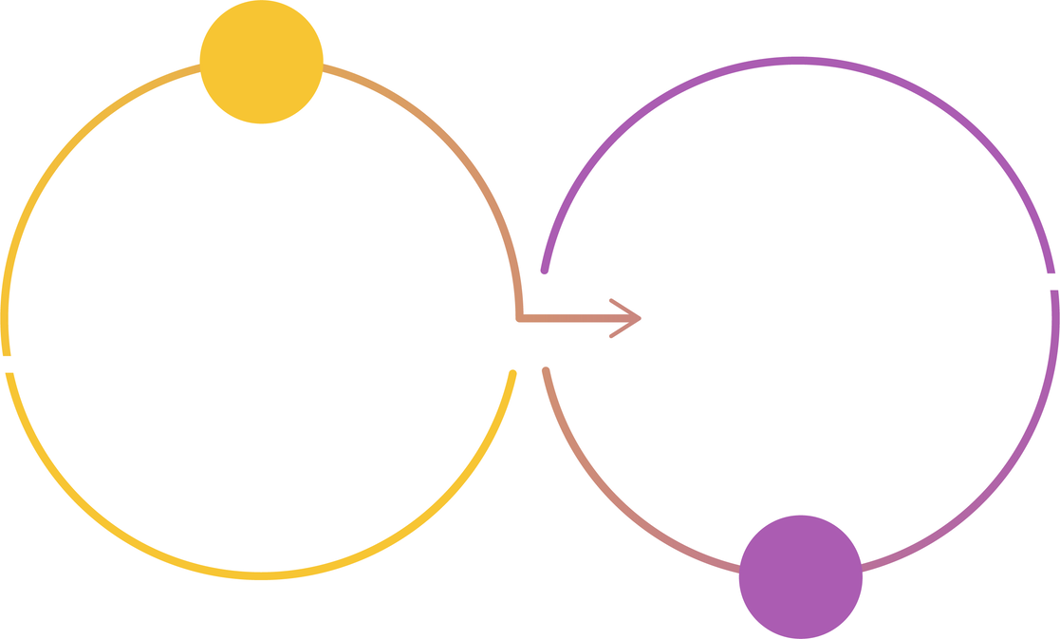

Adding Lasso for Sparsity
Where
Adding L1 Penalty
This is called Naive Elastic Net, differs from elastic net by scaling factor (1+λ)
A large enough λ1 → gives sparse β, and thus sparse Vi
Provides a flexible and efficient way to obtain sparse approximation
Two Stage Analysis
Find PCA Results
Use Theorem for Sparse Approximation

Slide 11
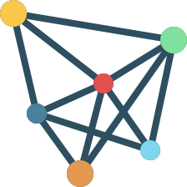
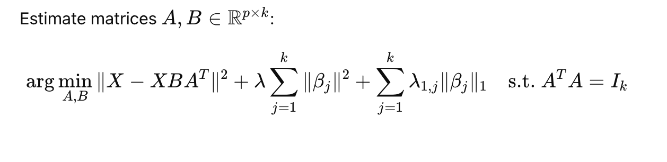
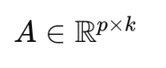
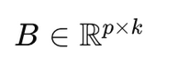
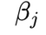
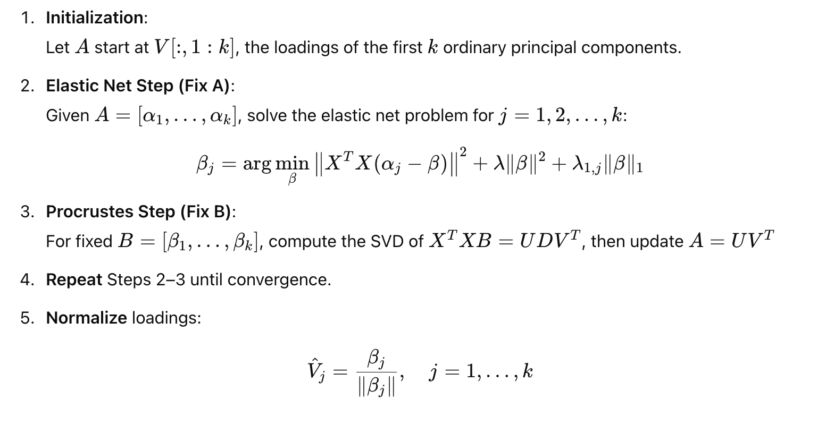

SPCA – Criterion and Algorithm
Orthonormal matrix of projection directions
Matrix of sparse loadings ( )
Determines which variables influence each component

Slide 12


SPCA: Pros & Cons
Pros
Produces sparse loadings → easier to identify important variables
Dimension Reduction, retains most variance using fewer variables
Flexibility: Controls sparsity via tuning (lasso) and stability via ridge
Efficient Algorithms: Solved via alternating updates + Elastic Net
Extends PCA: Reduces to standard PCA when sparsity penalty → 0
Better suited for High-Dimensional Data
Cons
Loss of Orthogonality: Sparse PCs are not guaranteed to be uncorrelated
Requires careful choice of λ and λ₁,j
Conceptually and computationally more involved than PCA

Slide 13
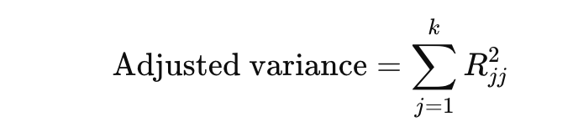

Adjusted Total Variance in SPCA
Issue: In SPCA, PCs may be correlated, so it overestimates true variance
Solution: Use adjusted total variance, corrects for overestimation due to correlated components
Using QR decomposition: Z = QR, where Q is orthonormal, R is upper-triangular.

Slide 14
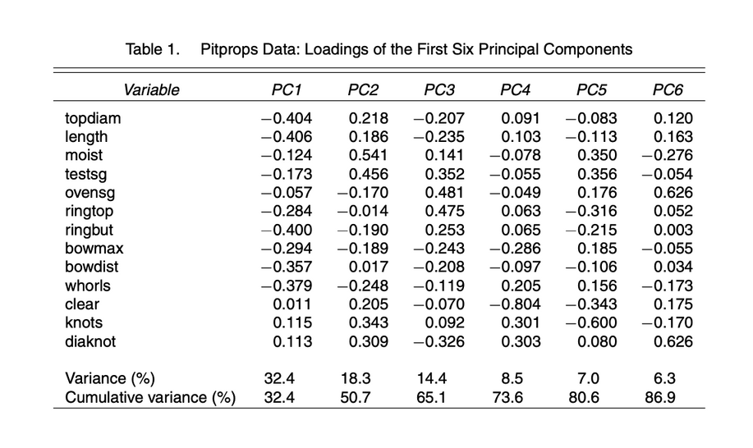
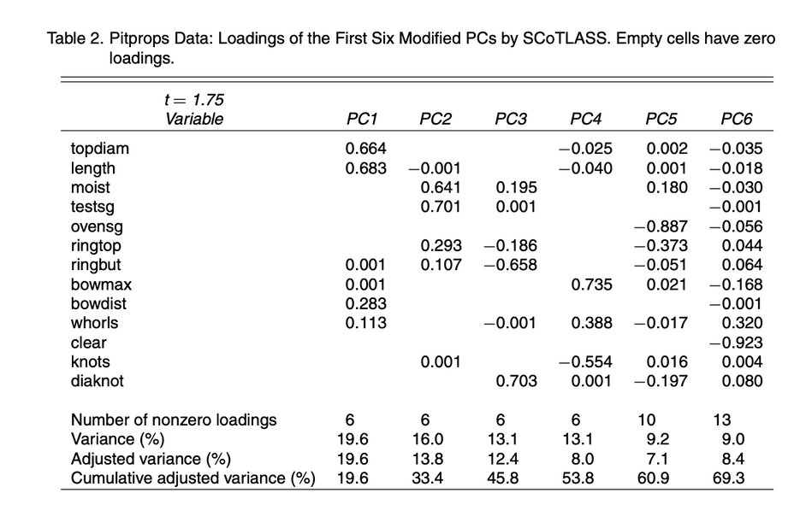
Pitprops Dataset Example – Tables
PCA Results
SCoTLASS Results

Slide 15
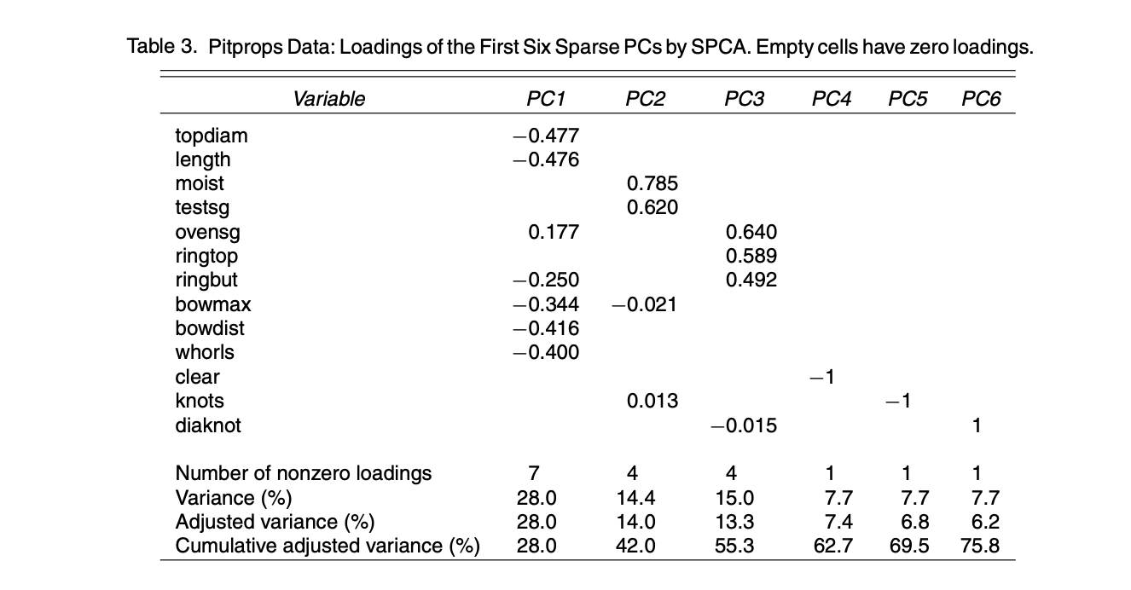
Pitprops Dataset – Tables
SPCA Results

Slide 16
Pitprops Data: Result Summary
SPCA | SCoTLASS | PCA
75.8% Variance Explained | 69.3% Variance Explained | Total variance explained by first 6 PCs
High sparsity | Sparse loadings | No sparsity

Slide 17
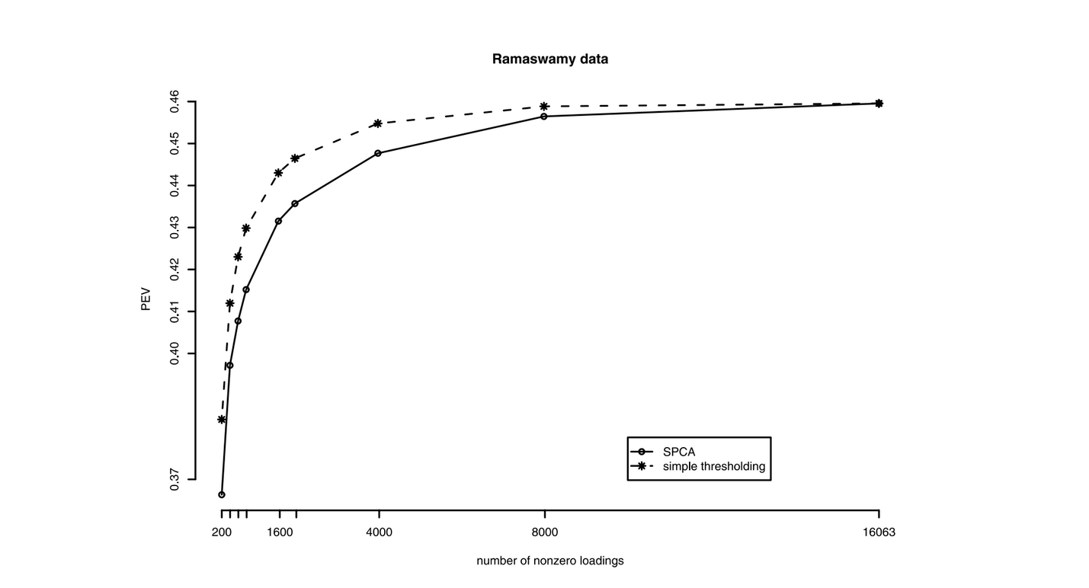
Gene Selection from Ramaswamy Microarray Data
Dataset: 16,063 genes, 144 samples
Goal: Identify genes that best explain gene expression variance
SPCA and Simple Thresholding Methods
Only ~2.5% of genes (≈400 genes) are enough to retain ~40% variance
Original first PC explains 46% of variance
SPCA trades slight variance loss for much higher interpretability

Slide 18



SPCA: A Principled Solution for Sparse Dimension Reduction
Based on regression-type optimization
Reduces to PCA when penalty vanishes
Flexible control over sparsity
Efficient algorithms for all data sizes
High explained variance
Better variable identification
SPCA is implemented in R - elasticnet

Slide 19


